Slide 1








Notes:
I know, you walked all the way over here to this hard to find room just to not have donuts. So this is my filler slide, to take up time while half the audience gets up and leaves. Though to make up for the lack of donuts here there will be a surprise for you on the way out so keep that in mind. For those who are staying,

Slide 2



Notes:
I know the description said “come enjoy a donut”, so this is the best I could do, let me know when you’re done enjoying it and we’ll continue. Fortunately this talk got rescheduled to lunch time, so having donuts would be a little weird anyway.

Slide 3

What is Data Engineering?
Use cases
Tech Stack
Concepts & Principles
Live demo
Joint Q&A
Overview
(~30 min)
(~15 min)
https://meet.ps/5b327jyo
Notes:
Before we dive in, I want to give you an overview of what we’re gonna cover. The first section is going to be me talking about data engineering. What is it? What the use cases? What does the tech stack look like? What are the important concepts and principles? I’m gonna use three examples to answer these questions, and this will be about 30 minutes.
The next part will be a hands-on, live demonstration of the stuff I covered in the first section, where I’ll pull up some code, explain what it does, and run a data pipeline locally, so you can see it working in real time. If you have your laptop with you, you can feel free to clone the repo and follow along. This will take 15 minutes.
The last part will be a joint Q&A with one of the data scientists from our team, Rita. I won’t be pausing the talk for questions, but you can submit questions using this link or QR code at any time, and this will also be at the bottom of every slide. But if you don’t have the iphone 17 plus pro with 9x zoom on the camera, you might wanna take a picture of this now. You don’t have to use this—we’ll also be calling on people who raise their hands in the Q&A, so feel free to do that too.
Let’s get into it!

Slide 4

Data engineers build systems that collect, manage, and convert raw data into usable information for data scientists and business analysts to interpret.
What is Data Engineering?
https://meet.ps/5b327jyo
Notes:
So, what is Data Engineering?
Data engineers build systems that collect, manage, and convert raw data into usable information.
So, I build systems that revolve around data. Why is that different from building say, an app on your phone? Well, just as an example, it can be hard to send very large amounts of data over the internet. Amazon has this data transfer service called Snowmobile, which is just a 45-foot long shipping container pulled by a semi truck that’s the fastest way to transfer exabytes of data. In case you think that’s a joke, it’s not a joke. This is 100% real. Semi-trucks don’t play a big part in our data pipelines, but it’s an extreme example to show how a system might be engineered differently if it revolves around data. If your data can’t fit on one computer, how do you do computations on it? Maybe that requires distributed computation, parallelization, and cloud systems and services, which have much larger compute and storage resources. And that’s just talking about the tools we use to actually build our systems.
When it comes to what the system does, just like how an app on your phone needs to understand and interpret the human mind, the systems that I build need to understand and interpret the processes that generate the data. Maybe we’re pulling from an unreliable source, and sometimes there’ll be data missing. We need error handling to cover that, and data quality analytics that can interpret that gap for the end users of the data. That’s the kind of systems we’re thinking about.
Keep in mind though that I’m presenting just one definition of data engineering. What I focus on may not represent data engineering across the board—DE means different things at different places.

Slide 5


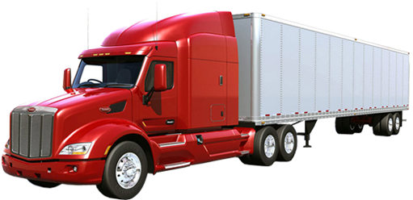
Data engineers build systems that collect, manage, and convert raw data into usable information for data scientists and business analysts to interpret.
What is Data Engineering?
https://meet.ps/5b327jyo
Notes:
So, I build systems that revolve around data. Why is that different from building say, an app on your phone? Well, just as an example, it can be hard to send very large amounts of data over the internet. Amazon has this data transfer service called Snowmobile, which is just a 45-foot long shipping container pulled by a semi truck that’s the fastest way to transfer exabytes of data. In case you think that’s a joke, it’s not a joke. This is 100% real. Semi-trucks don’t play a big part in our data pipelines, but it’s an extreme example to show how a system might be engineered differently if it revolves around data. If your data can’t fit on one computer, how do you do computations on it? Maybe that requires distributed computation, parallelization, and cloud systems and services, which have much larger compute and storage resources. And that’s just talking about the tools we use to actually build our systems.
When it comes to what the system does, just like how an app on your phone needs to understand and interpret the human mind, the systems that I build need to understand and interpret the processes that generate the data. Maybe we’re pulling from an unreliable source, and sometimes there’ll be data missing. We need error handling to cover that, and data quality analytics that can interpret that gap for the end users of the data. That’s the kind of systems we’re thinking about.
Keep in mind though that I’m presenting just one definition of data engineering. What I focus on may not represent data engineering across the board—DE means different things at different places.

Slide 6
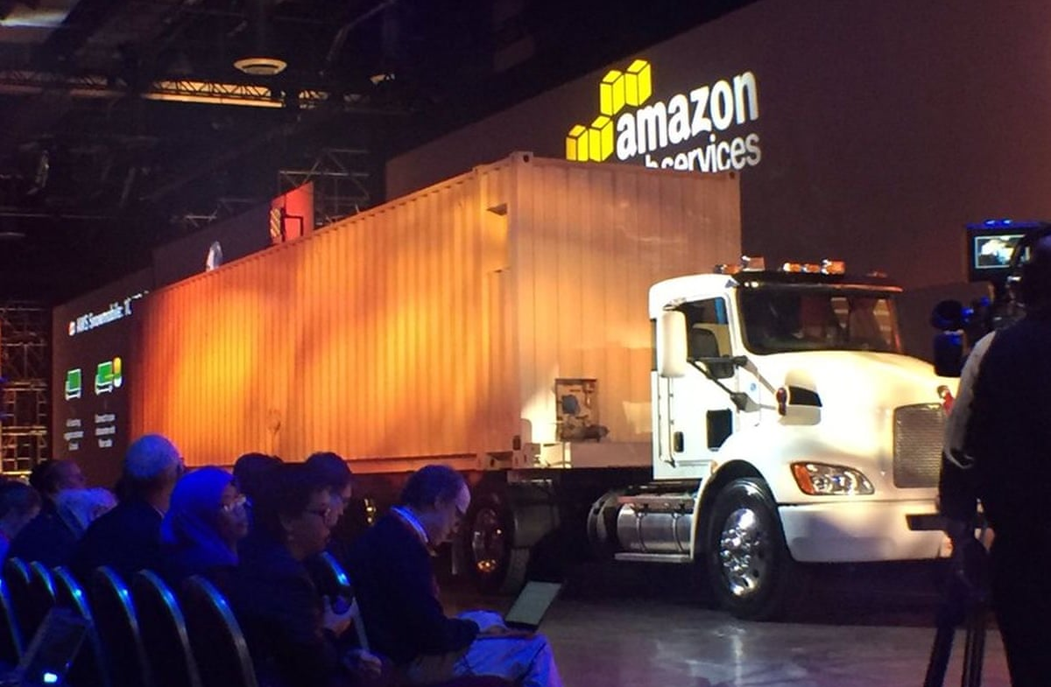
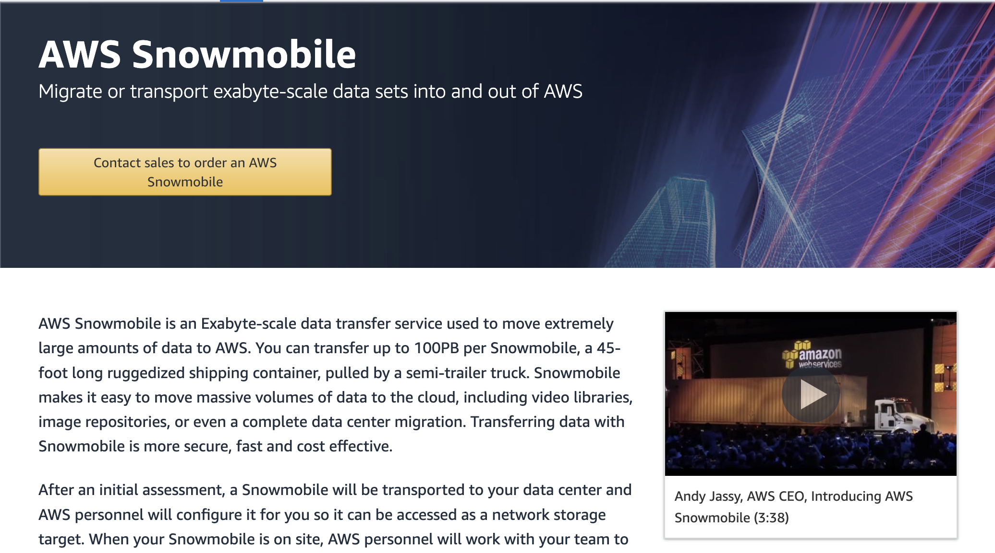
Data engineers build systems that collect, manage, and convert raw data into usable information for data scientists and business analysts to interpret.
What is Data Engineering?
https://meet.ps/5b327jyo
Notes:
So, I build systems that revolve around data. Why is that different from building say, an app on your phone? Well, just as an example, it can be hard to send very large amounts of data over the internet. Amazon has this data transfer service called Snowmobile, which is just a 45-foot long shipping container pulled by a semi truck that’s the fastest way to transfer exabytes of data. In case you think that’s a joke, it’s not a joke. This is 100% real. Semi-trucks don’t play a big part in our data pipelines, but it’s an extreme example to show how a system might be engineered differently if it revolves around data. If your data can’t fit on one computer, how do you do computations on it? Maybe that requires distributed computation, parallelization, and cloud systems and services, which have much larger compute and storage resources. And that’s just talking about the tools we use to actually build our systems.
When it comes to what the system does, just like how an app on your phone needs to understand and interpret the human mind, the systems that I build need to understand and interpret the processes that generate the data. Maybe we’re pulling from an unreliable source, and sometimes there’ll be data missing. We need error handling to cover that, and data quality analytics that can interpret that gap for the end users of the data. That’s the kind of systems we’re thinking about.
Keep in mind though that I’m presenting just one definition of data engineering. What I focus on may not represent data engineering across the board—DE means different things at different places.

Slide 7
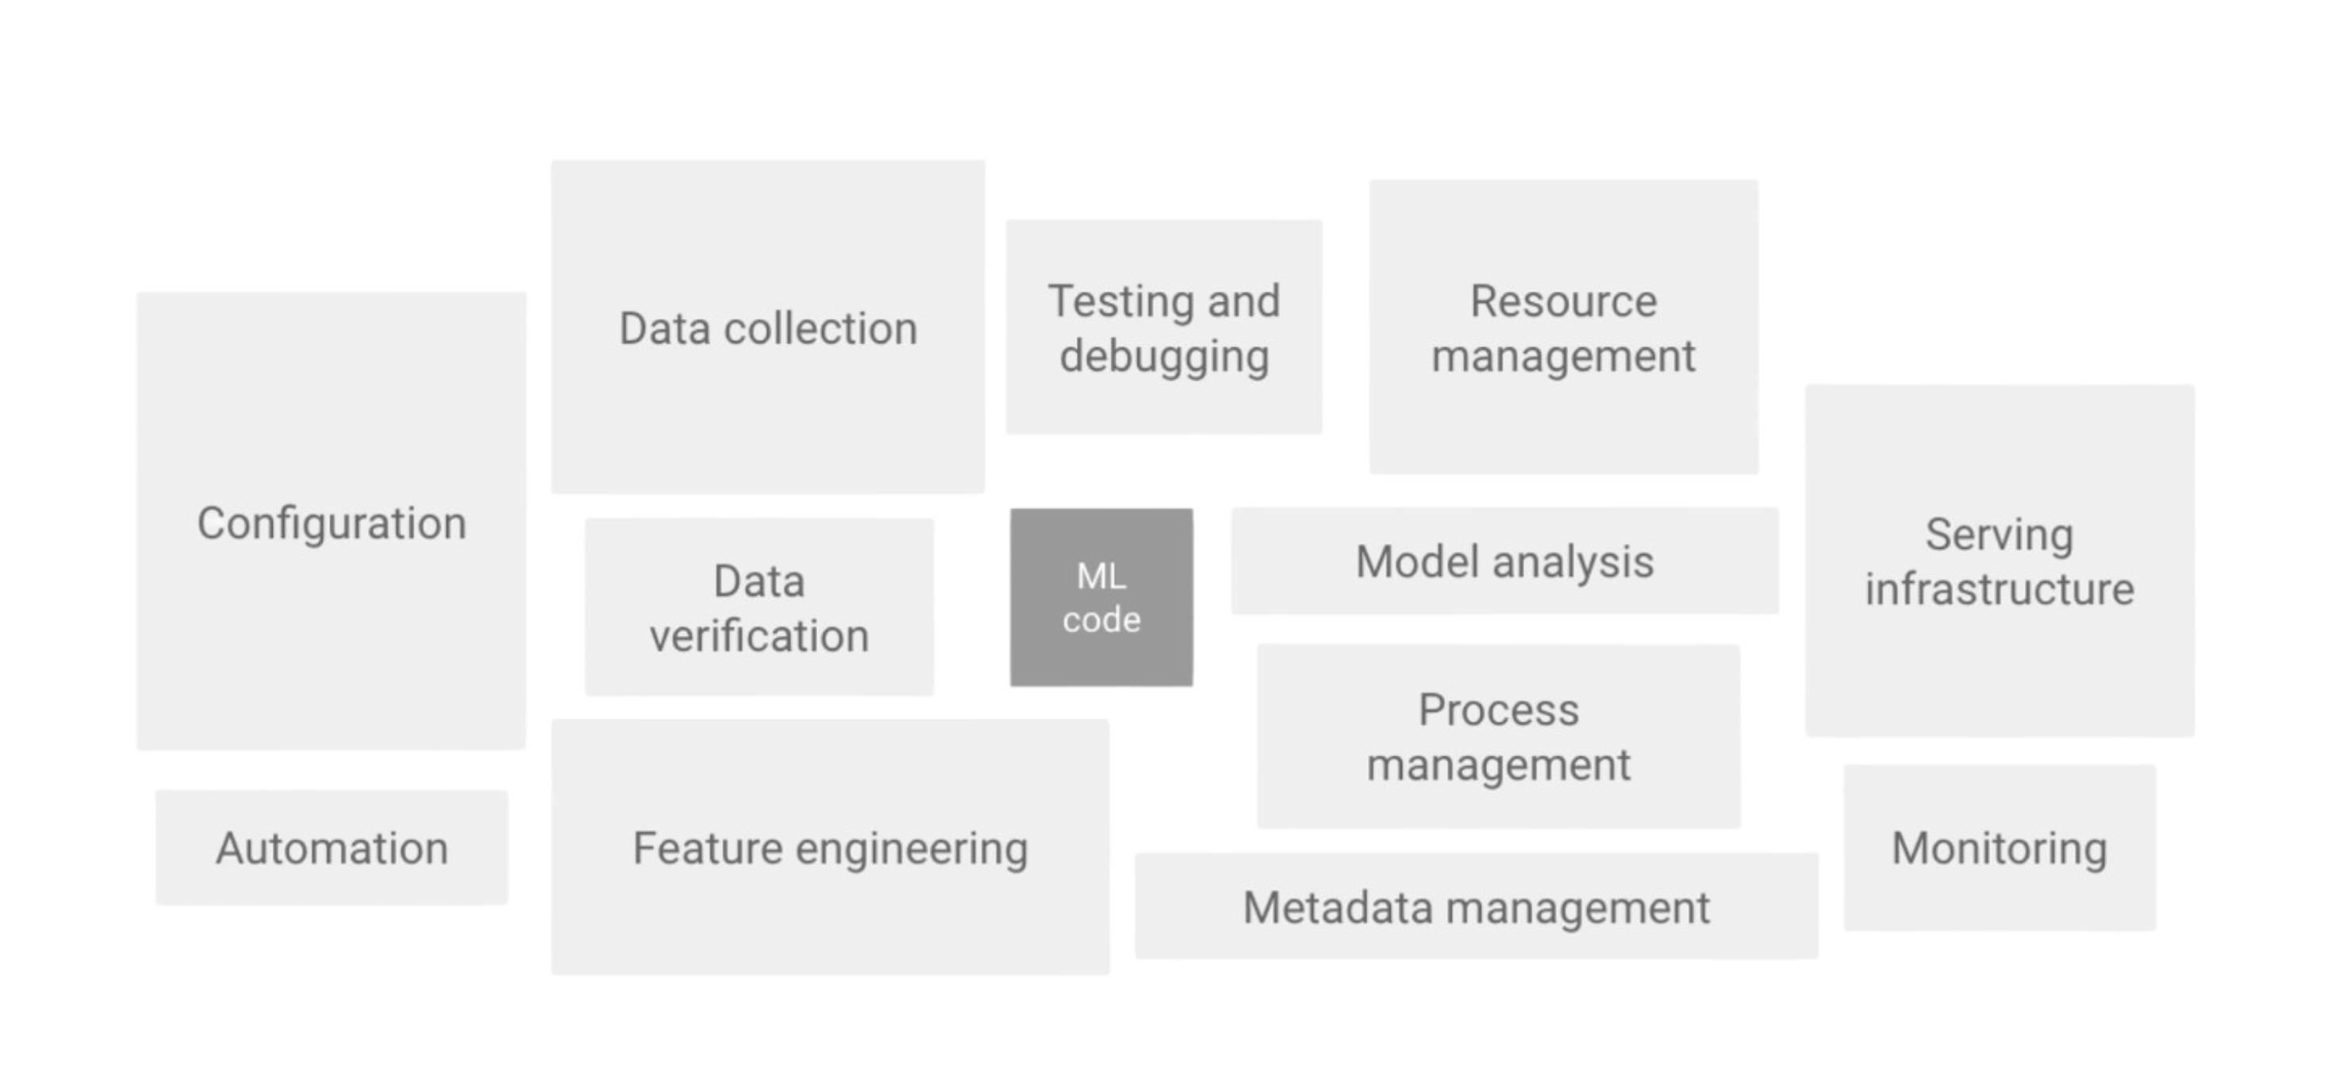
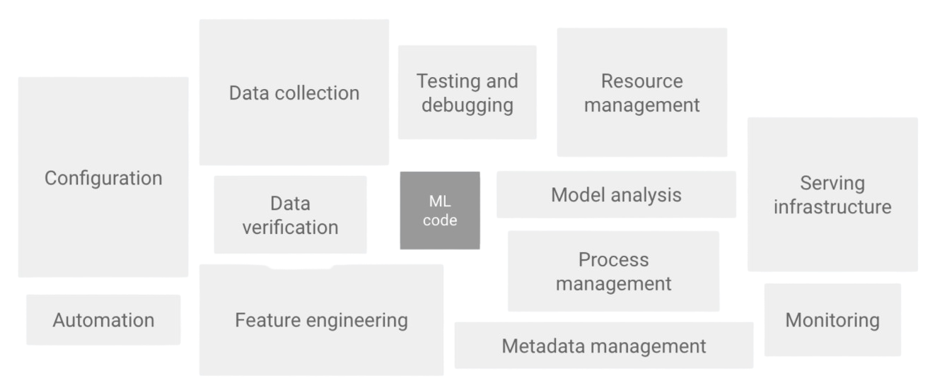
What is Data Engineering?
“the real challenge isn't building an ML model, the challenge is building an integrated ML system and to continuously operate it in production” -Google
https://meet.ps/5b327jyo
Notes:
This up here is a direct quote from Google’s cloud architecture site. As they say, the challenge isn't building a model, it’s building an integrated system and continuously operating it in production. Cuz doing anything once is easy. Making things happen continuously, at scale, is hard. They have this accompanying diagram, that shows how really only a small fraction of a real-world machine learning system is actually machine learning code, which is not what people expect. I think a good analogy is let’s imagine this is your problem set, that small bit in the middle is the code you actually wrote, while all this surrounding stuff is the code you copy and pasted from stack overflow. I’m using the generic you, not singling anybody out here. But we all know that that little bit in the middle makes us feel good, but this stuff is what got that, working.
And this stuff, this is things like configuration, automation, data collection, data verification, testing, resource management, infrastructure, and monitoring. All of this stuff, this is data engineering.

Slide 8




Use Case #1
https://meet.ps/5b327jyo
Notes:
Here’s one example of how we do that.
At T Rowe, we have a group called Investment & Product Content, which normally spends weeks interviewing people to get their finger on pulse of the markets. They want to know, what are people thinking and talking about? How are people feeling? What the emerging themes and trends?
This is a pretty labor intensive process, and my team is here to make it easier. One way to know what people are talking about is to look at the news. But reading every single news article is also time consuming. We want to organize and synthesize news in a meaningful way.

Slide 9

Use Case #1
https://meet.ps/5b327jyo
Notes:
Here’s one example of how we do that.
At T Rowe, we have a group called Investment & Product Content, which normally spends weeks interviewing people to get their finger on pulse of the markets. They want to know, what are people thinking and talking about? How are people feeling? What the emerging themes and trends?
This is a pretty labor intensive process, and my team is here to make it easier. One way to know what people are talking about is to look at the news. But reading every single news article is also time consuming. We want to organize and synthesize news in a meaningful way.

Slide 10


Use Case #1
:
Modeling Financial News
https://meet.ps/5b327jyo
Notes:
So, our first use case is modeling financial news. we bought a license from a financial news source to do topic modeling on their articles. They gave us a historical archive of all their articles, and we're responsible for getting new articles by hitting an API they expose to us.

Slide 11
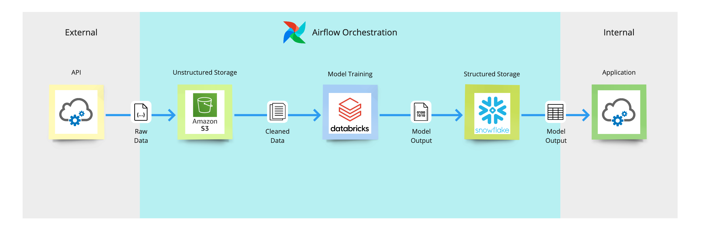
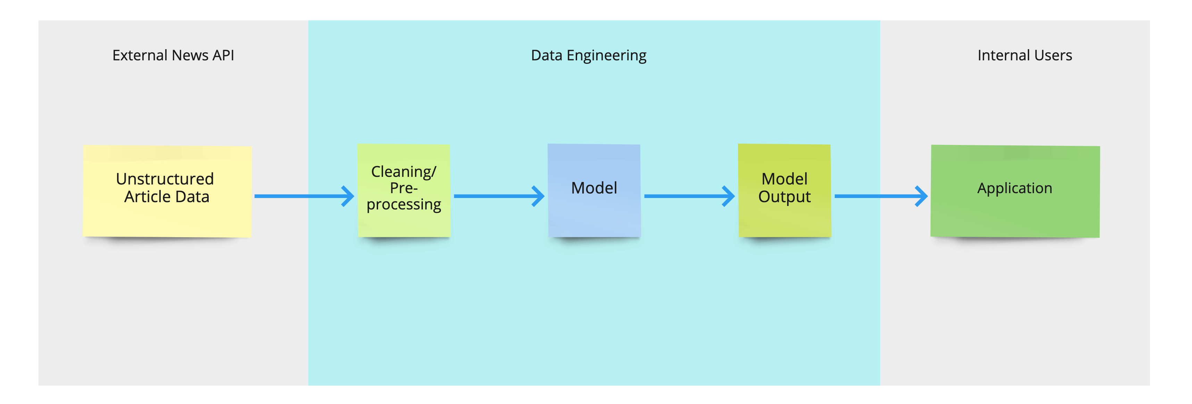
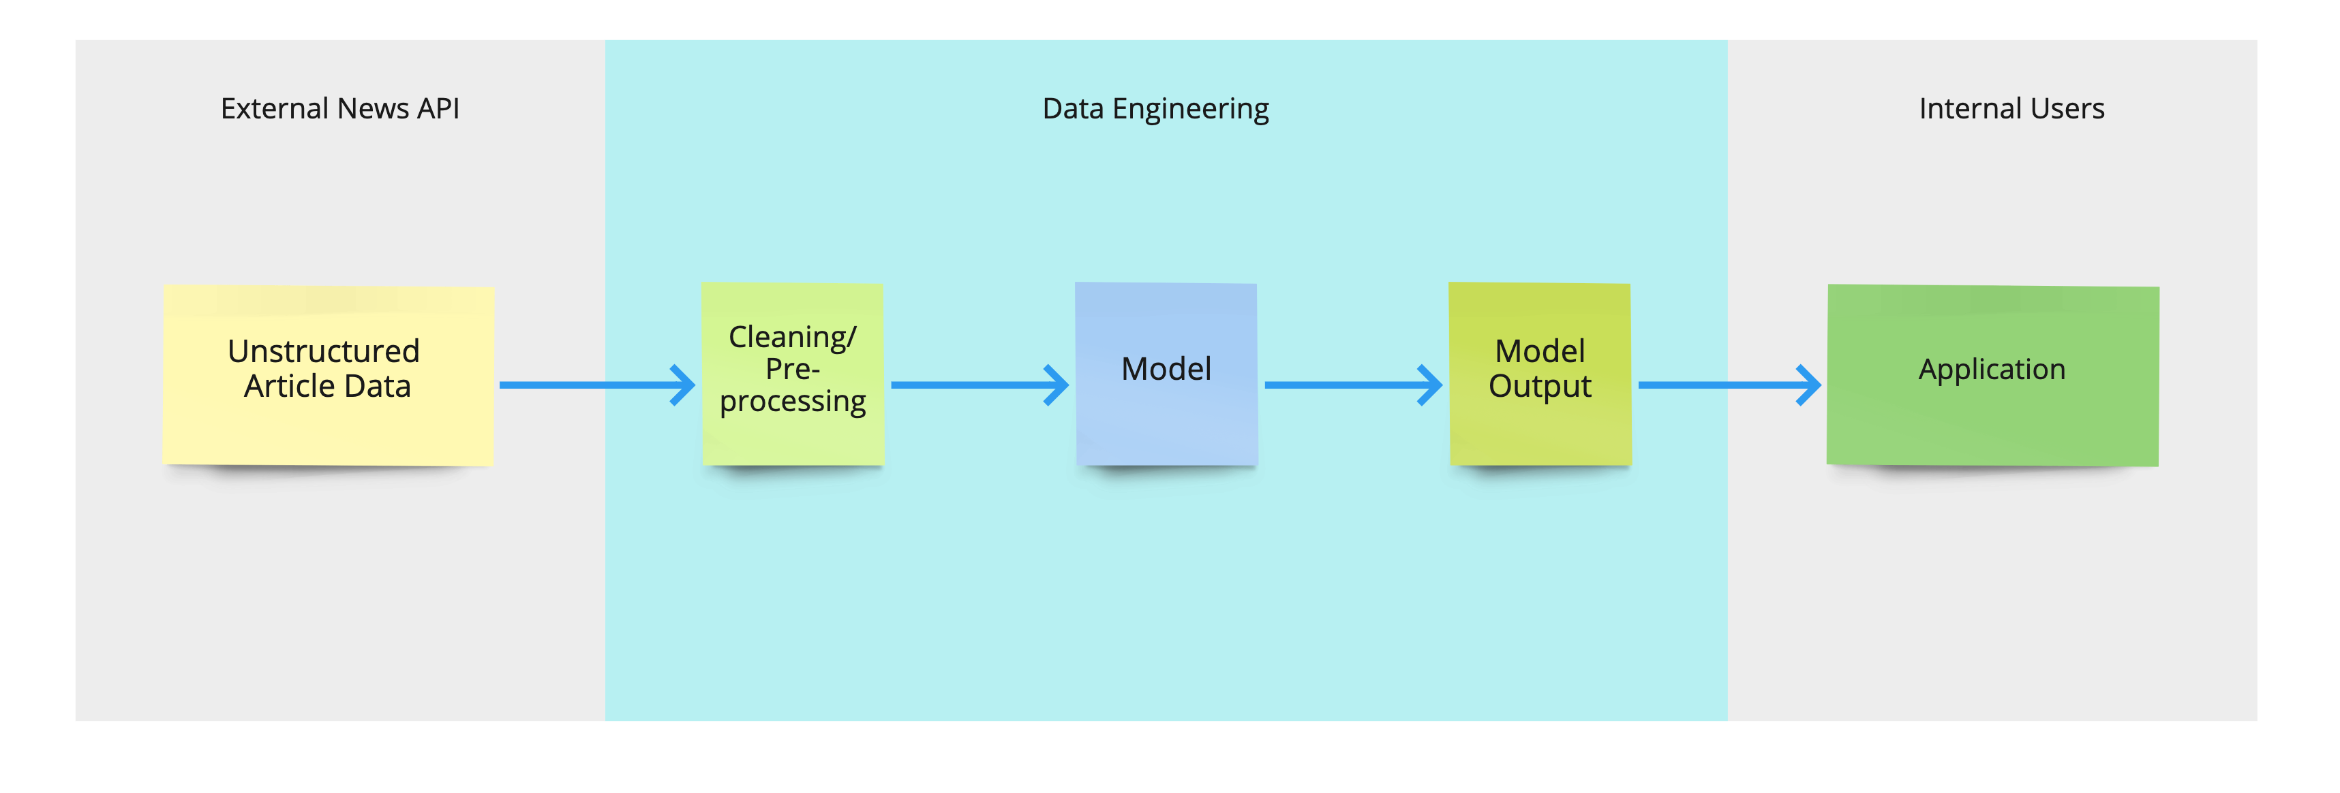
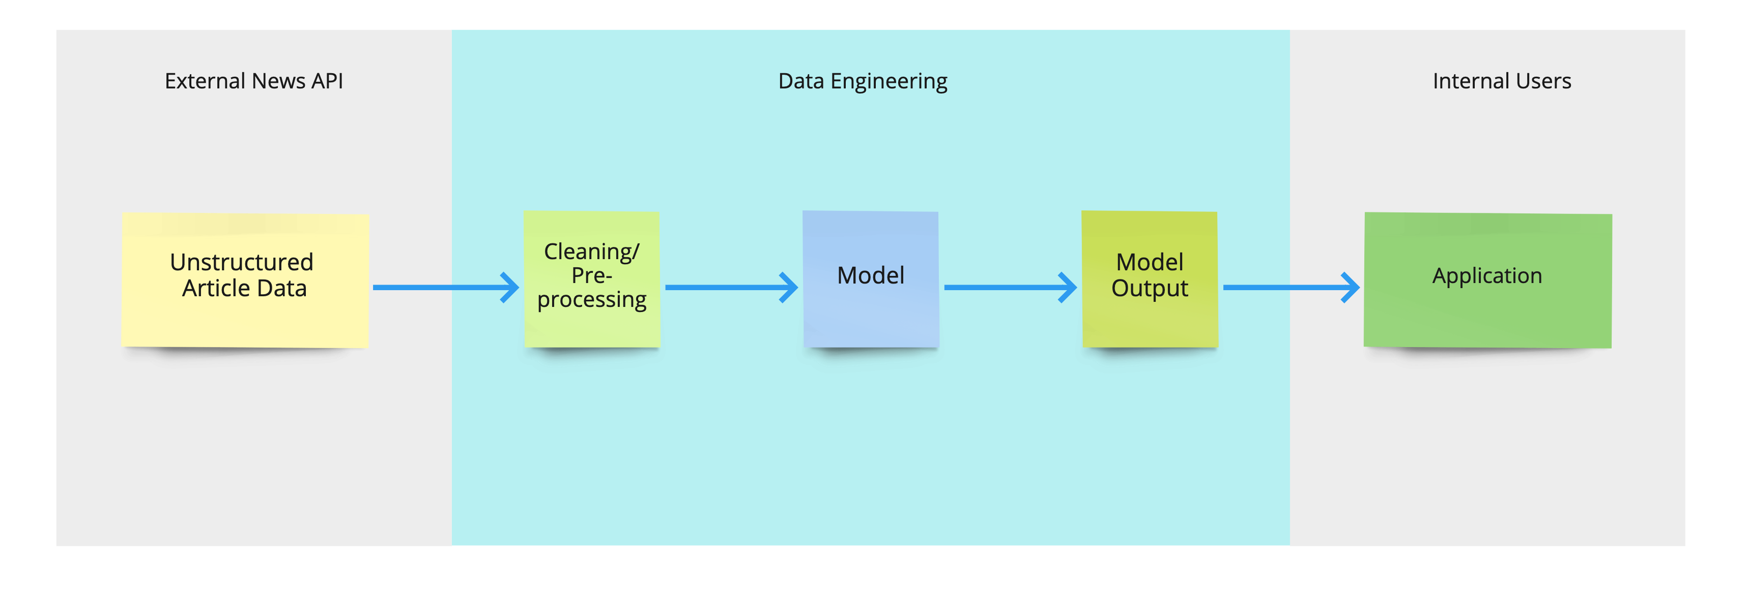
News Modeling: Data Pipeline
https://meet.ps/5b327jyo
Notes:
Putting all these pieces together, let's revisit the data flow diagram, but now with some concrete knowledge of where the data lives. Every day, Airflow triggers the pulling of the raw data from the news API and dumping of it into s3. it’s cleaned and then brought into Databricks, where airflow triggers the retraining of the model, and then we take the results of the model to the database of one of our applications. So, that's the basics of how we might build a pretty simple data pipeline. Keep in mind that there are lots of other tools and tech stacks that could be used to achieve the same purpose.

Slide 12
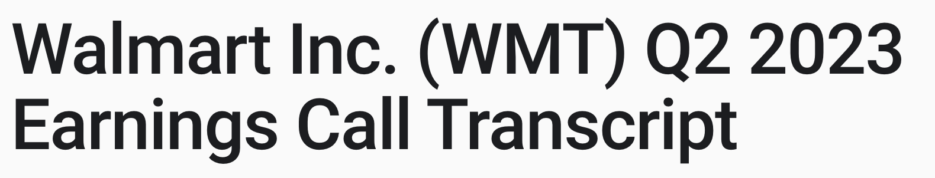
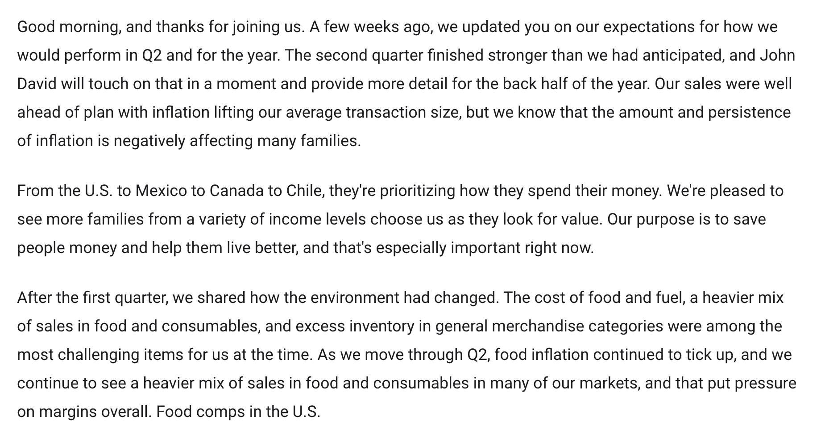
Use Case #2
https://meet.ps/5b327jyo
Notes:
Now that you know what tools we’re using, let’s look at a more complicated data pipeline.
This next use case relates to earnings calls, which are press releases that companies hold every quarter to talk about how they’re doing and what their concerns are. Here’s an example from Walmart– they’re saying that they did better in the second quarter than they expected, that inflation is causing ppl to look to them for cheaper goods, etc.

Slide 13
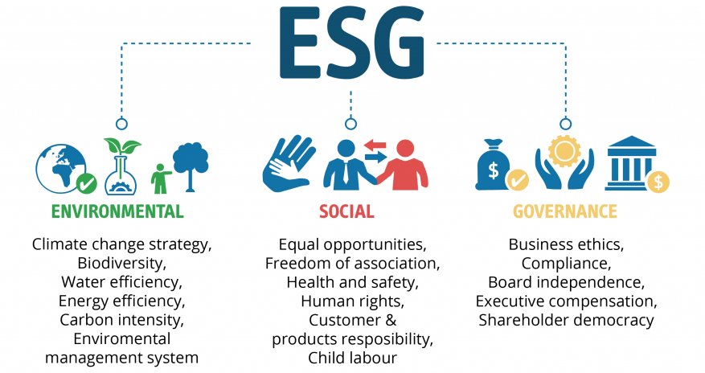
Use Case #2
:
Finding Keywords in Earnings Call Transcripts
https://meet.ps/5b327jyo
Notes:
The reason why we’re interested in this is because of something called ESG – it stands for environmental, social, and governance, and its a framework for thinking about investments that’s motivated by the idea that companies should be assessed on this criteria, because investors care about these things, and they can impact performance. These are things like a company’s environmental impact and carbon intensity, their labor practices and consumer responsibility, and business ethics. One way our analysts are assessing companies on this is by looking for ESG keywords in earnings call transcripts, as flags for understanding how companies are approaching different issues. For example, an analyst might be interested in assessing gender pay equity across companies, and so they might look at earnings calls to see if CEOs are talking about proactively trying to close their gender pay gap, or if they’re fending off questions about a gender pay discrimination lawsuit.

Slide 14
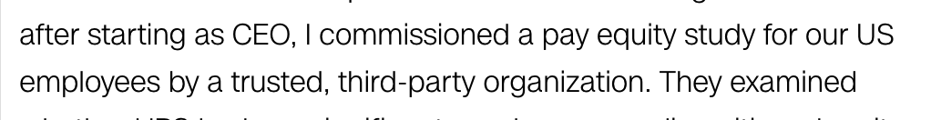
Use Case #2:
Finding Keywords in Earnings Call Transcripts
https://meet.ps/5b327jyo
Notes:
The reason why we’re interested in this is because of something called ESG – it stands for environmental, social, and governance, and its a framework for thinking about investments that’s motivated by the idea that companies should be assessed on this criteria, because investors care about these things, and they can impact performance. These are things like a company’s environmental impact and carbon intensity, their labor practices and consumer responsibility, and business ethics. One way our analysts are assessing companies on this is by looking for mentions of ESG keywords in earnings call transcripts, as flags for understanding how companies are approaching different issues. For example, an analyst might be interested in assessing gender pay equity across companies, and so they might look at earnings calls to see if CEOs are talking about proactively trying to close their gender pay gap, or if they’re fending off questions about a gender pay discrimination lawsuit.

Slide 15
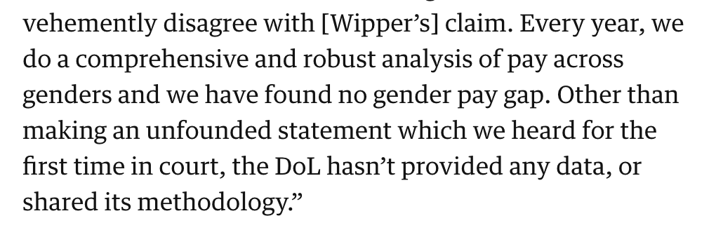
Use Case #2:
Finding Keywords in Earnings Call Transcripts
https://meet.ps/5b327jyo
Notes:
The reason why we’re interested in this is because of something called ESG – it stands for environmental, social, and governance, and its a framework for thinking about investments that’s motivated by the idea that companies should be assessed on this criteria, because investors care about these things, and they can impact performance. These are things like a company’s environmental impact and carbon intensity, their labor practices and consumer responsibility, and business ethics. One way our analysts are assessing companies on this is by looking for mentions of ESG keywords in earnings call transcripts, as flags for understanding how companies are approaching different issues. For example, an analyst might be interested in assessing gender pay equity across companies, and so they might look at earnings calls to see if CEOs are talking about proactively trying to close their gender pay gap, or if they’re fending off questions about a gender pay discrimination lawsuit.

Slide 16
Use Case #2:
Finding Keywords in Earnings Call Transcripts
https://meet.ps/5b327jyo
Notes:
So, we’d like to search earnings calls for esg words. The problem here is that the same word can have multiple meanings, and be used in different ways. For example, in this transcript, they use the words “the environment” but are they talking about the ecological environment? No, they’re talking about the cost of food and fuel, which is part of the business environment. We want filter out the words that aren’t actually related to esg. We can do that by training a classification model to predict whether or not a given word is actually being used in an esg context.

Slide 17
Use Case #2:
Finding Keywords in Earnings Call Transcripts
https://meet.ps/5b327jyo
Notes:
So, we’d like to search earnings calls for esg words. The problem here is that the same word can have multiple meanings, and be used in different ways. For example, in this transcript, they use the words “the environment” but are they talking about the ecological environment? No, they’re talking about the cost of food and fuel, which is part of the business environment. We want filter out the words that aren’t actually related to esg. We can do that by training a classification model to predict whether or not a given word is actually being used in an esg context.

